Slide 1
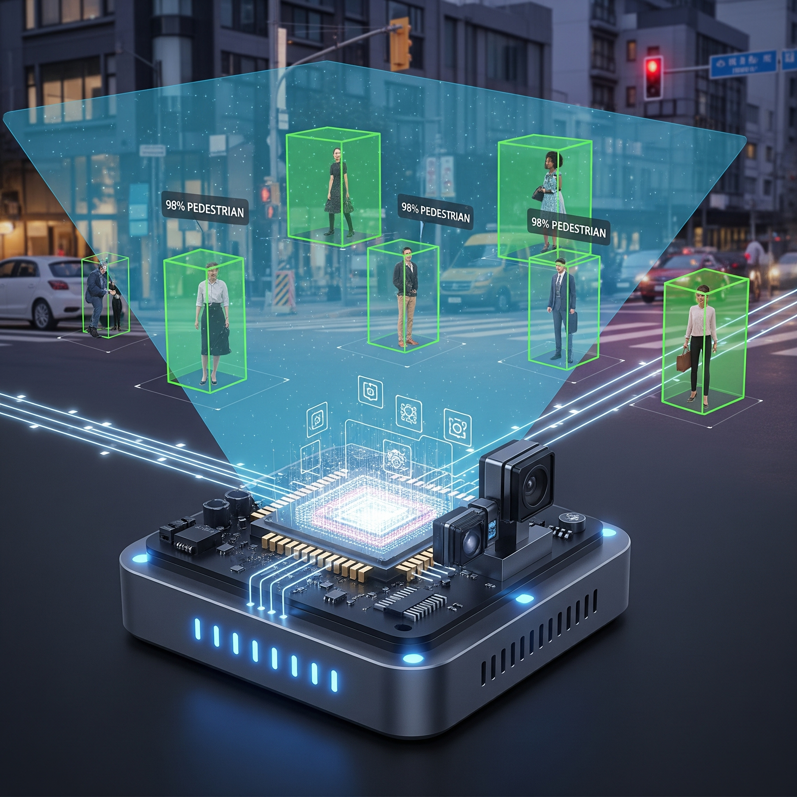
Real-Time Pedestrian Detection on IoT Edge Devices: A Lightweight Deep Learning Approach
Research by Muhammad Dany Alfikri, Rafael Kaliski
arXiv:2409.15740v1
Presented by Mehmet Ali Yılmaz for SENG423

Slide 2
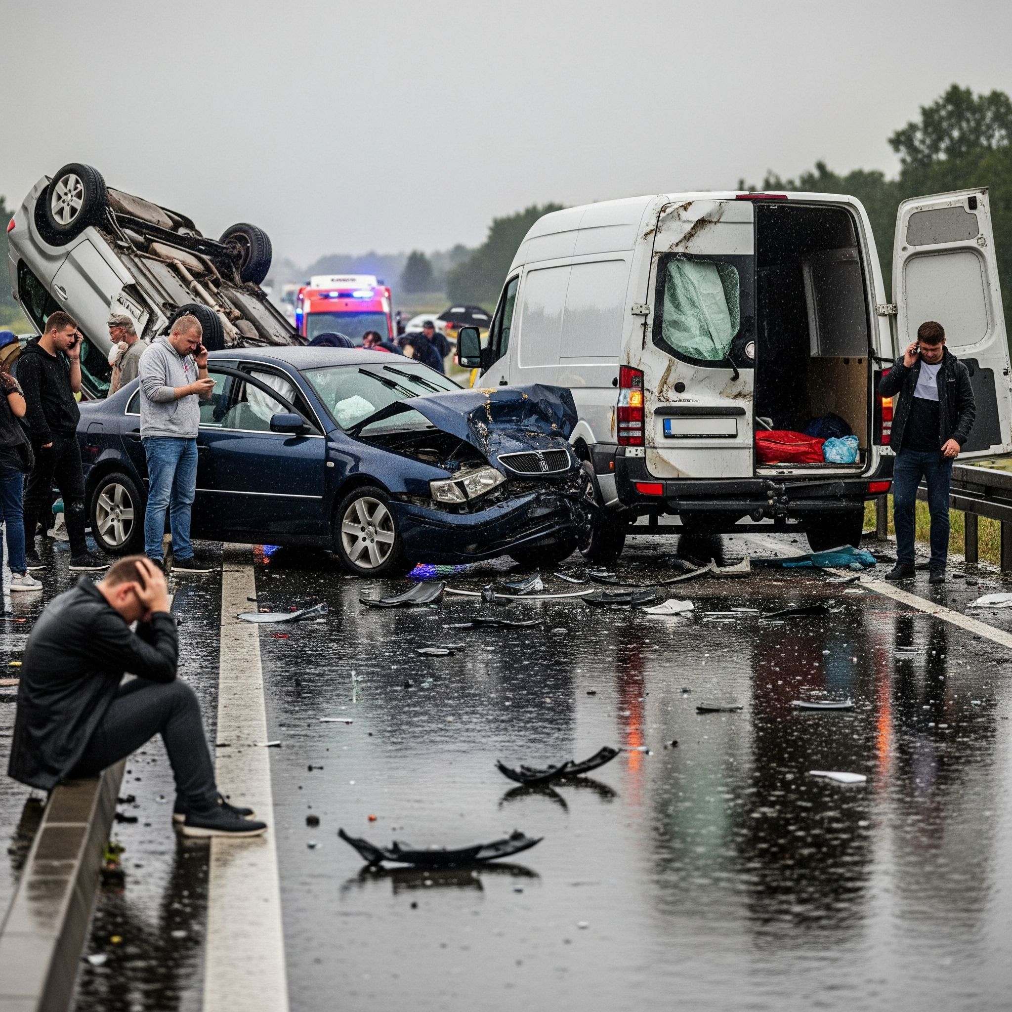
The Problem: Human Error in Traffic
Momentary lapses cause serious traffic accidents
Human error leads to many pedestrian fatalities
Taiwan reported over 16,600 accidents in 2021
Technology can provide solutions to this problem

Slide 3
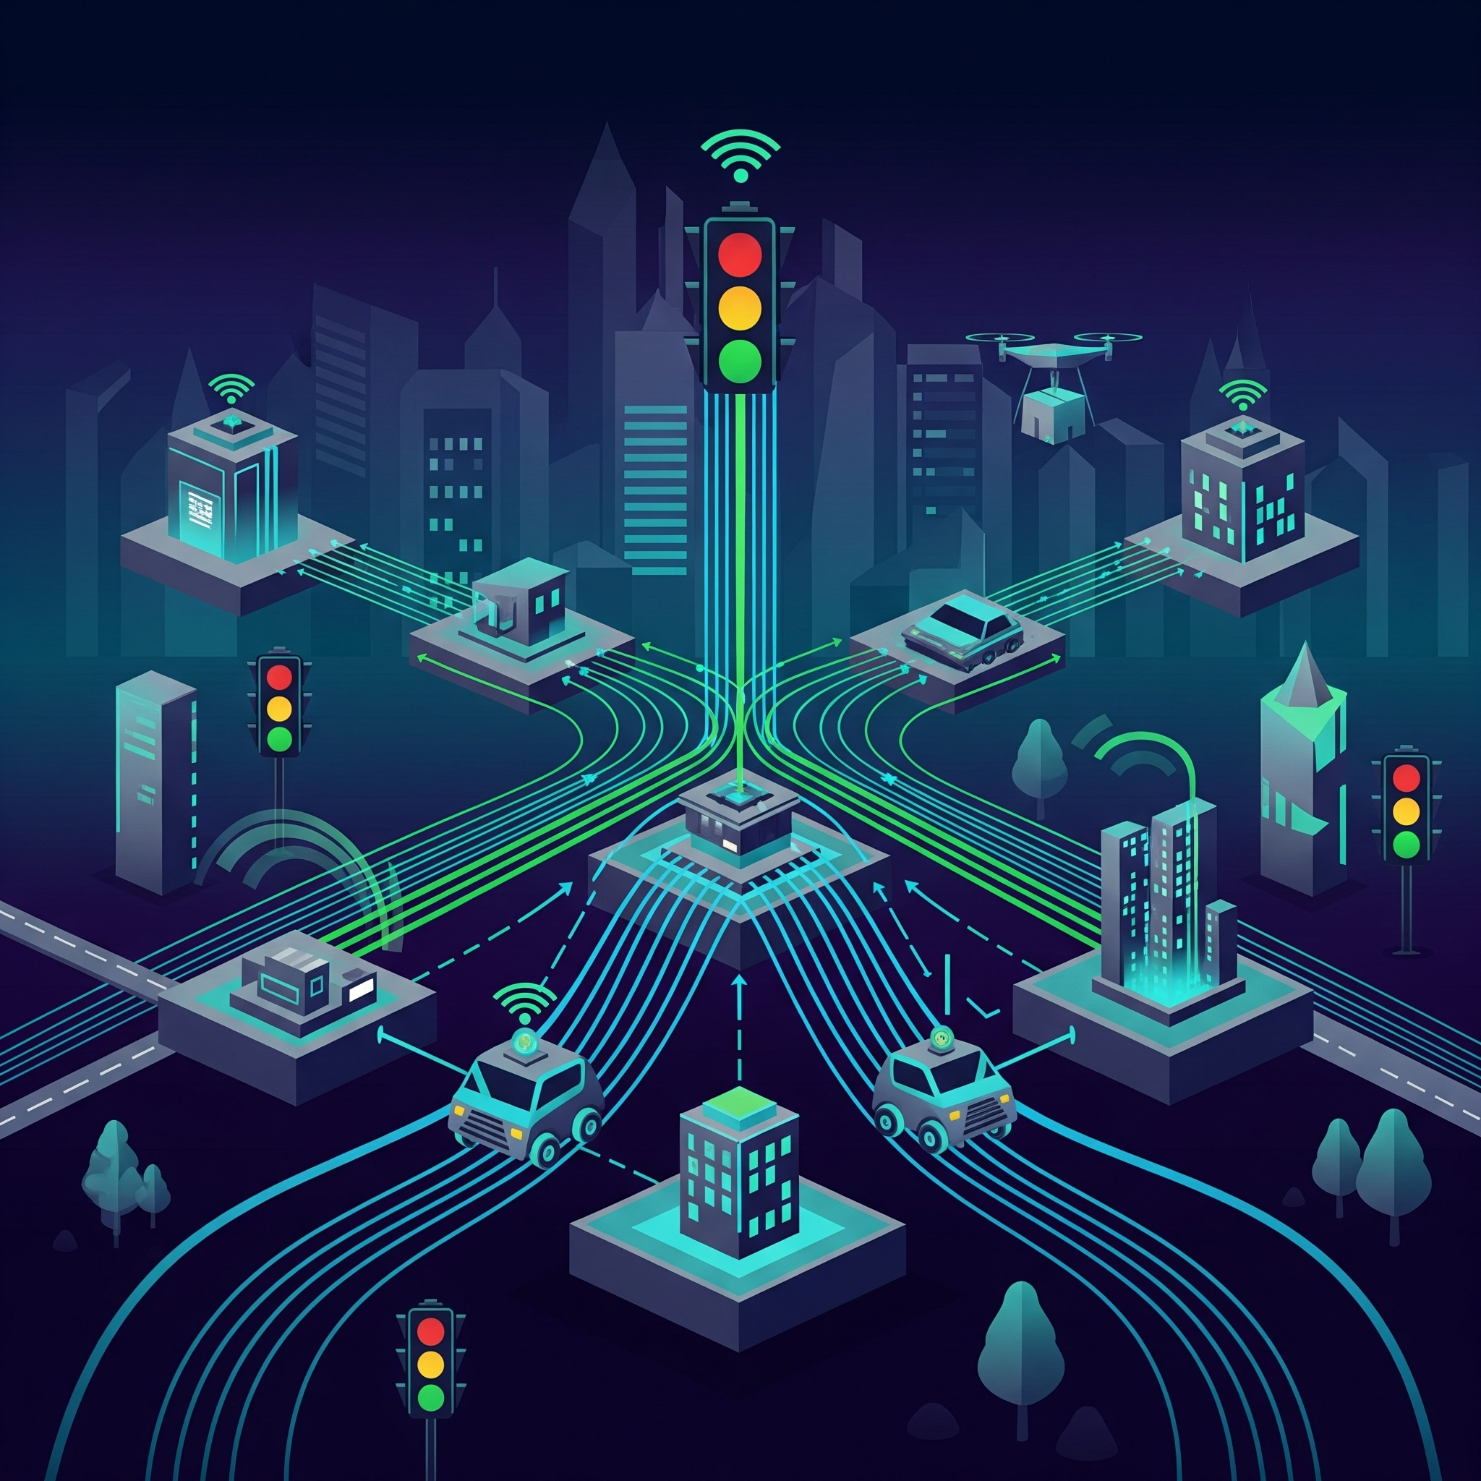
Solution Approach: Intelligent Transportation Systems (ITS)
Cloud approach has high latency issues
Edge approach offers very low latency
Real-time responses are crucial for safety
Local processing ensures quick actions
Note: In safety, not seconds, but milliseconds save lives.

Slide 4
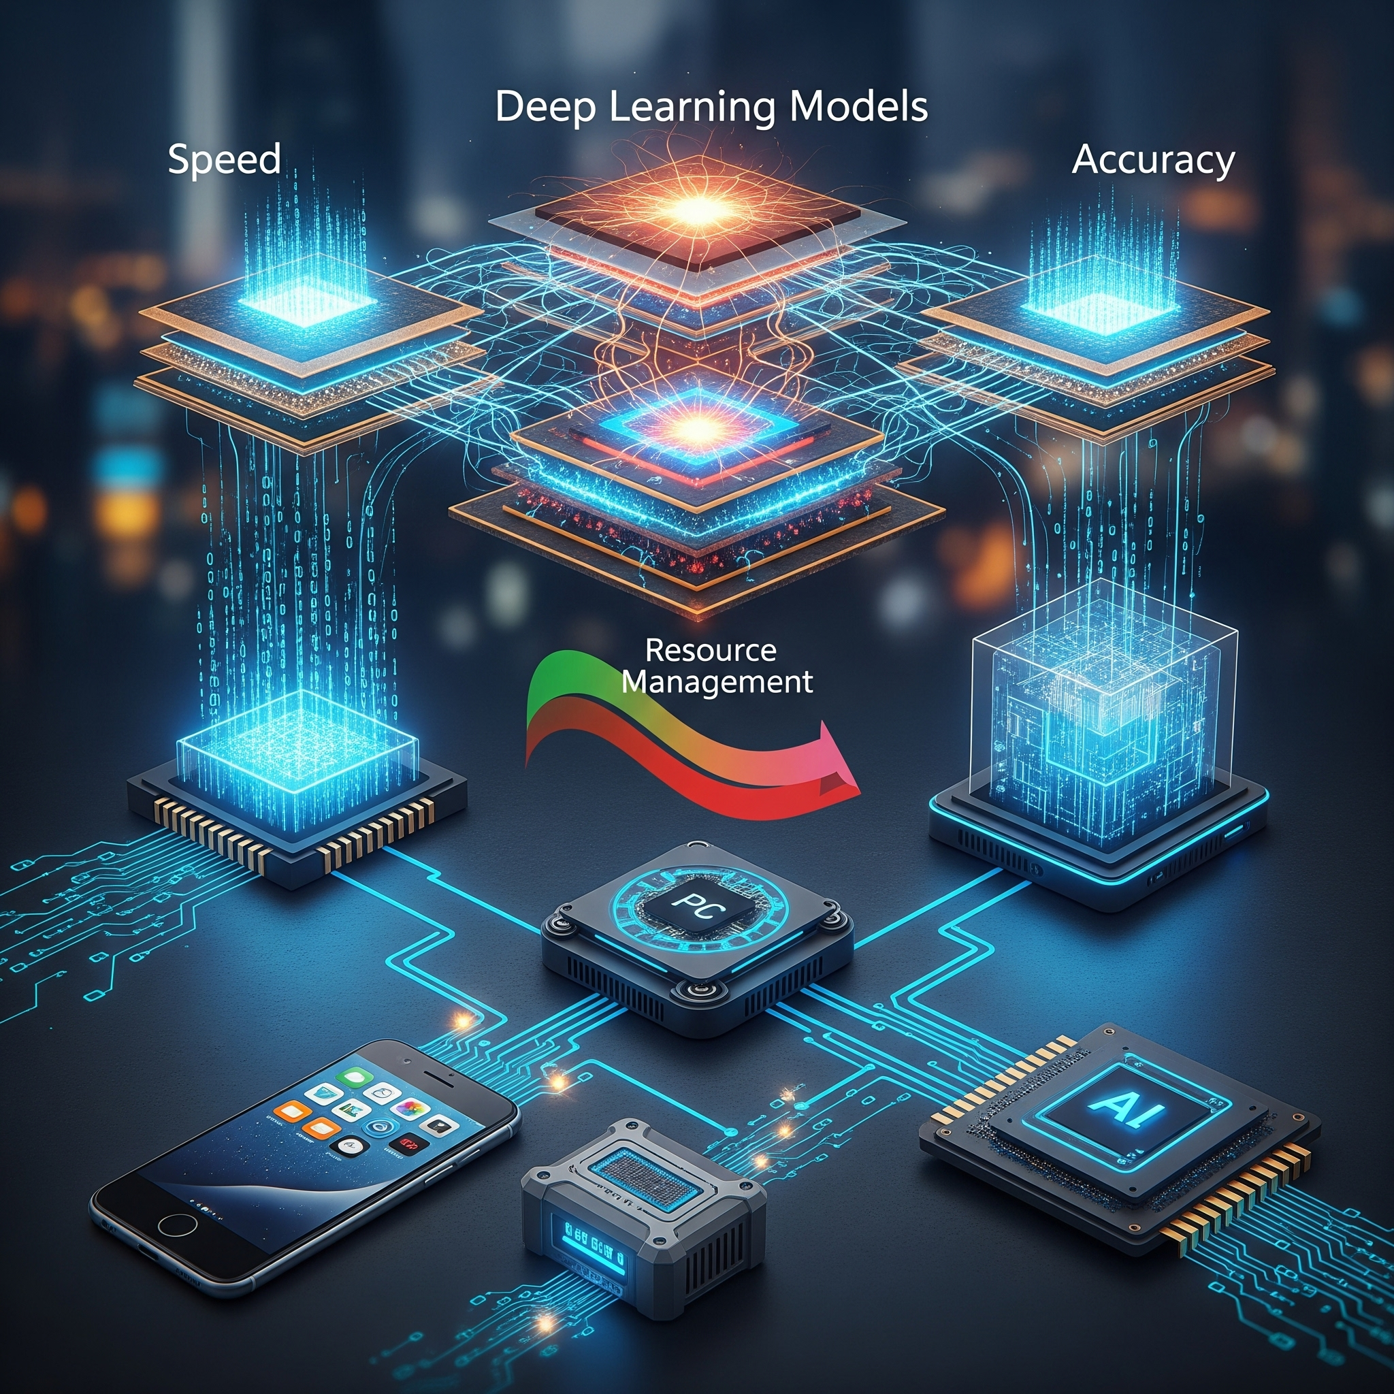
The Research Dilemma
Edge devices offer low latency, but have limited resources.
Deep learning models provide accuracy but are often heavy.
A core question is how to balance these factors.
Fast, accurate, and lightweight models are needed.
The Core Question: On resource-constrained IoT devices, how do we run a model that is FAST, ACCURATE, and LIGHTWEIGHT at the same time?

Slide 5
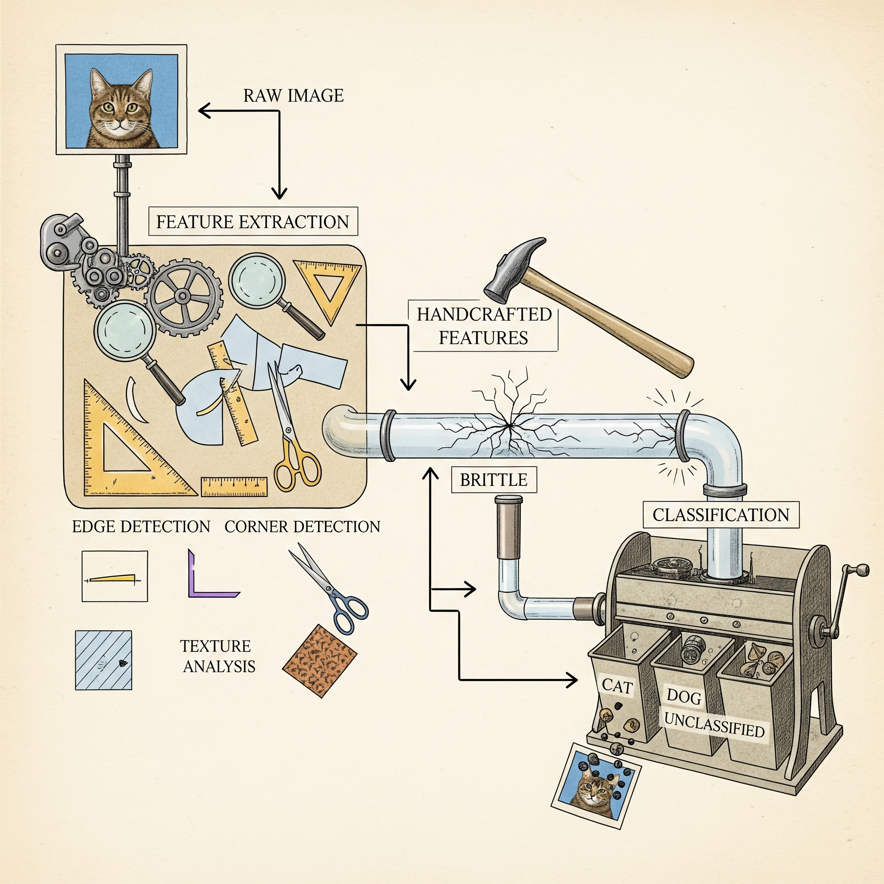
Current Approaches (1): Classical Methods
Classical methods rely on handcrafted features
HOG(Histogram of Oriented Gradients) + SVM is a common example
Manual definition of shape and texture features
Issues with brittleness (weak against different angles, partial occlusion) and slow processing
Impractical for real-time applications

Slide 6
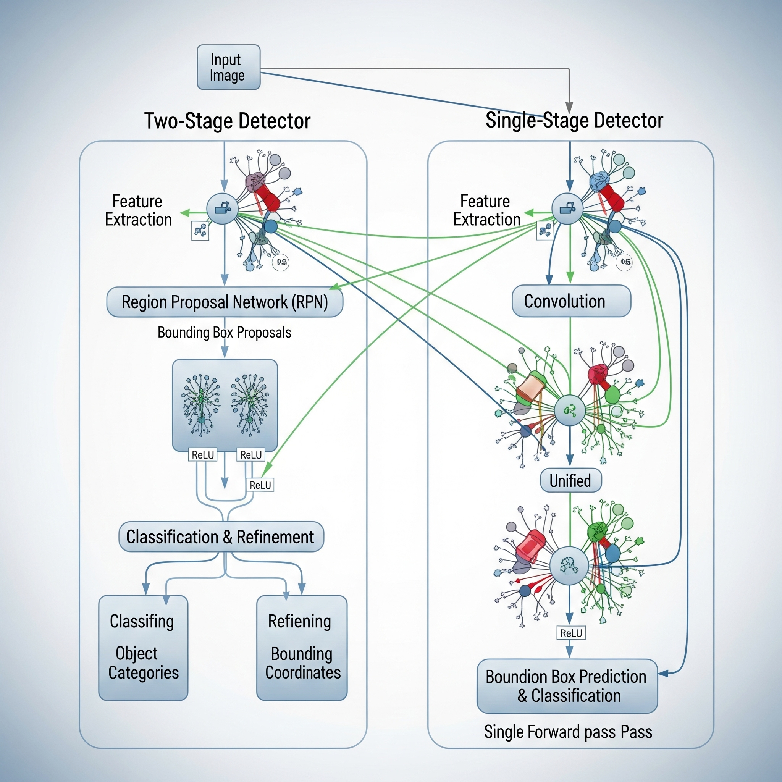
Current Approaches (2): Deep Learning (CNN)
Two-stage detectors offer high accuracy but are slower ( Faster R-CNN )
Single-stage detectors like YOLO are very fast (YOLO, SSD)
Single-stage models may have slightly lower accuracy
Deep learning CNNs are used in both approaches

Slide 7

The Research Gap & Contribution
The Need: For Edge (IoT) devices, 'speed' and 'lightness' are the priority.
The Gap: Even fast single-stage models (like YOLO) can still be too 'heavy' for constrained IoT devices.
This Paper's Core Contribution:
Based on the YOLO architecture,
To design a lightweight and optimized deep learning model,
To run efficiently on low-cost edge devices like the Nvidia Jetson Nano.

Slide 8
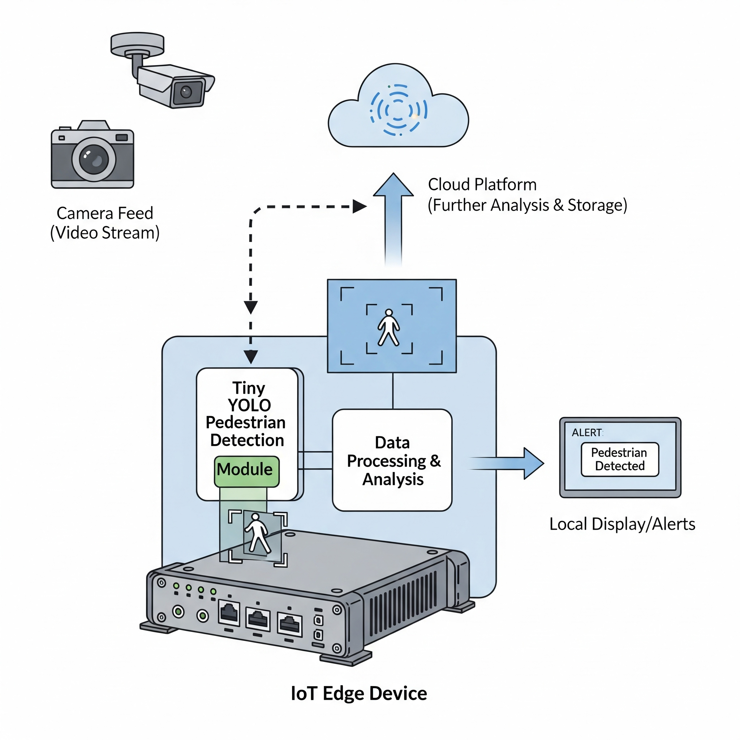
Proposed System Architecture
Camera captures image or video data
IoT Edge Device processes data locally
Tiny YOLO model detects pedestrians on device
Detection results (only JSON) sent via MQTT protocol(fast and very lightweight protocol)
Server publishes alerts to relevant subscribers(vehicles)

Slide 9
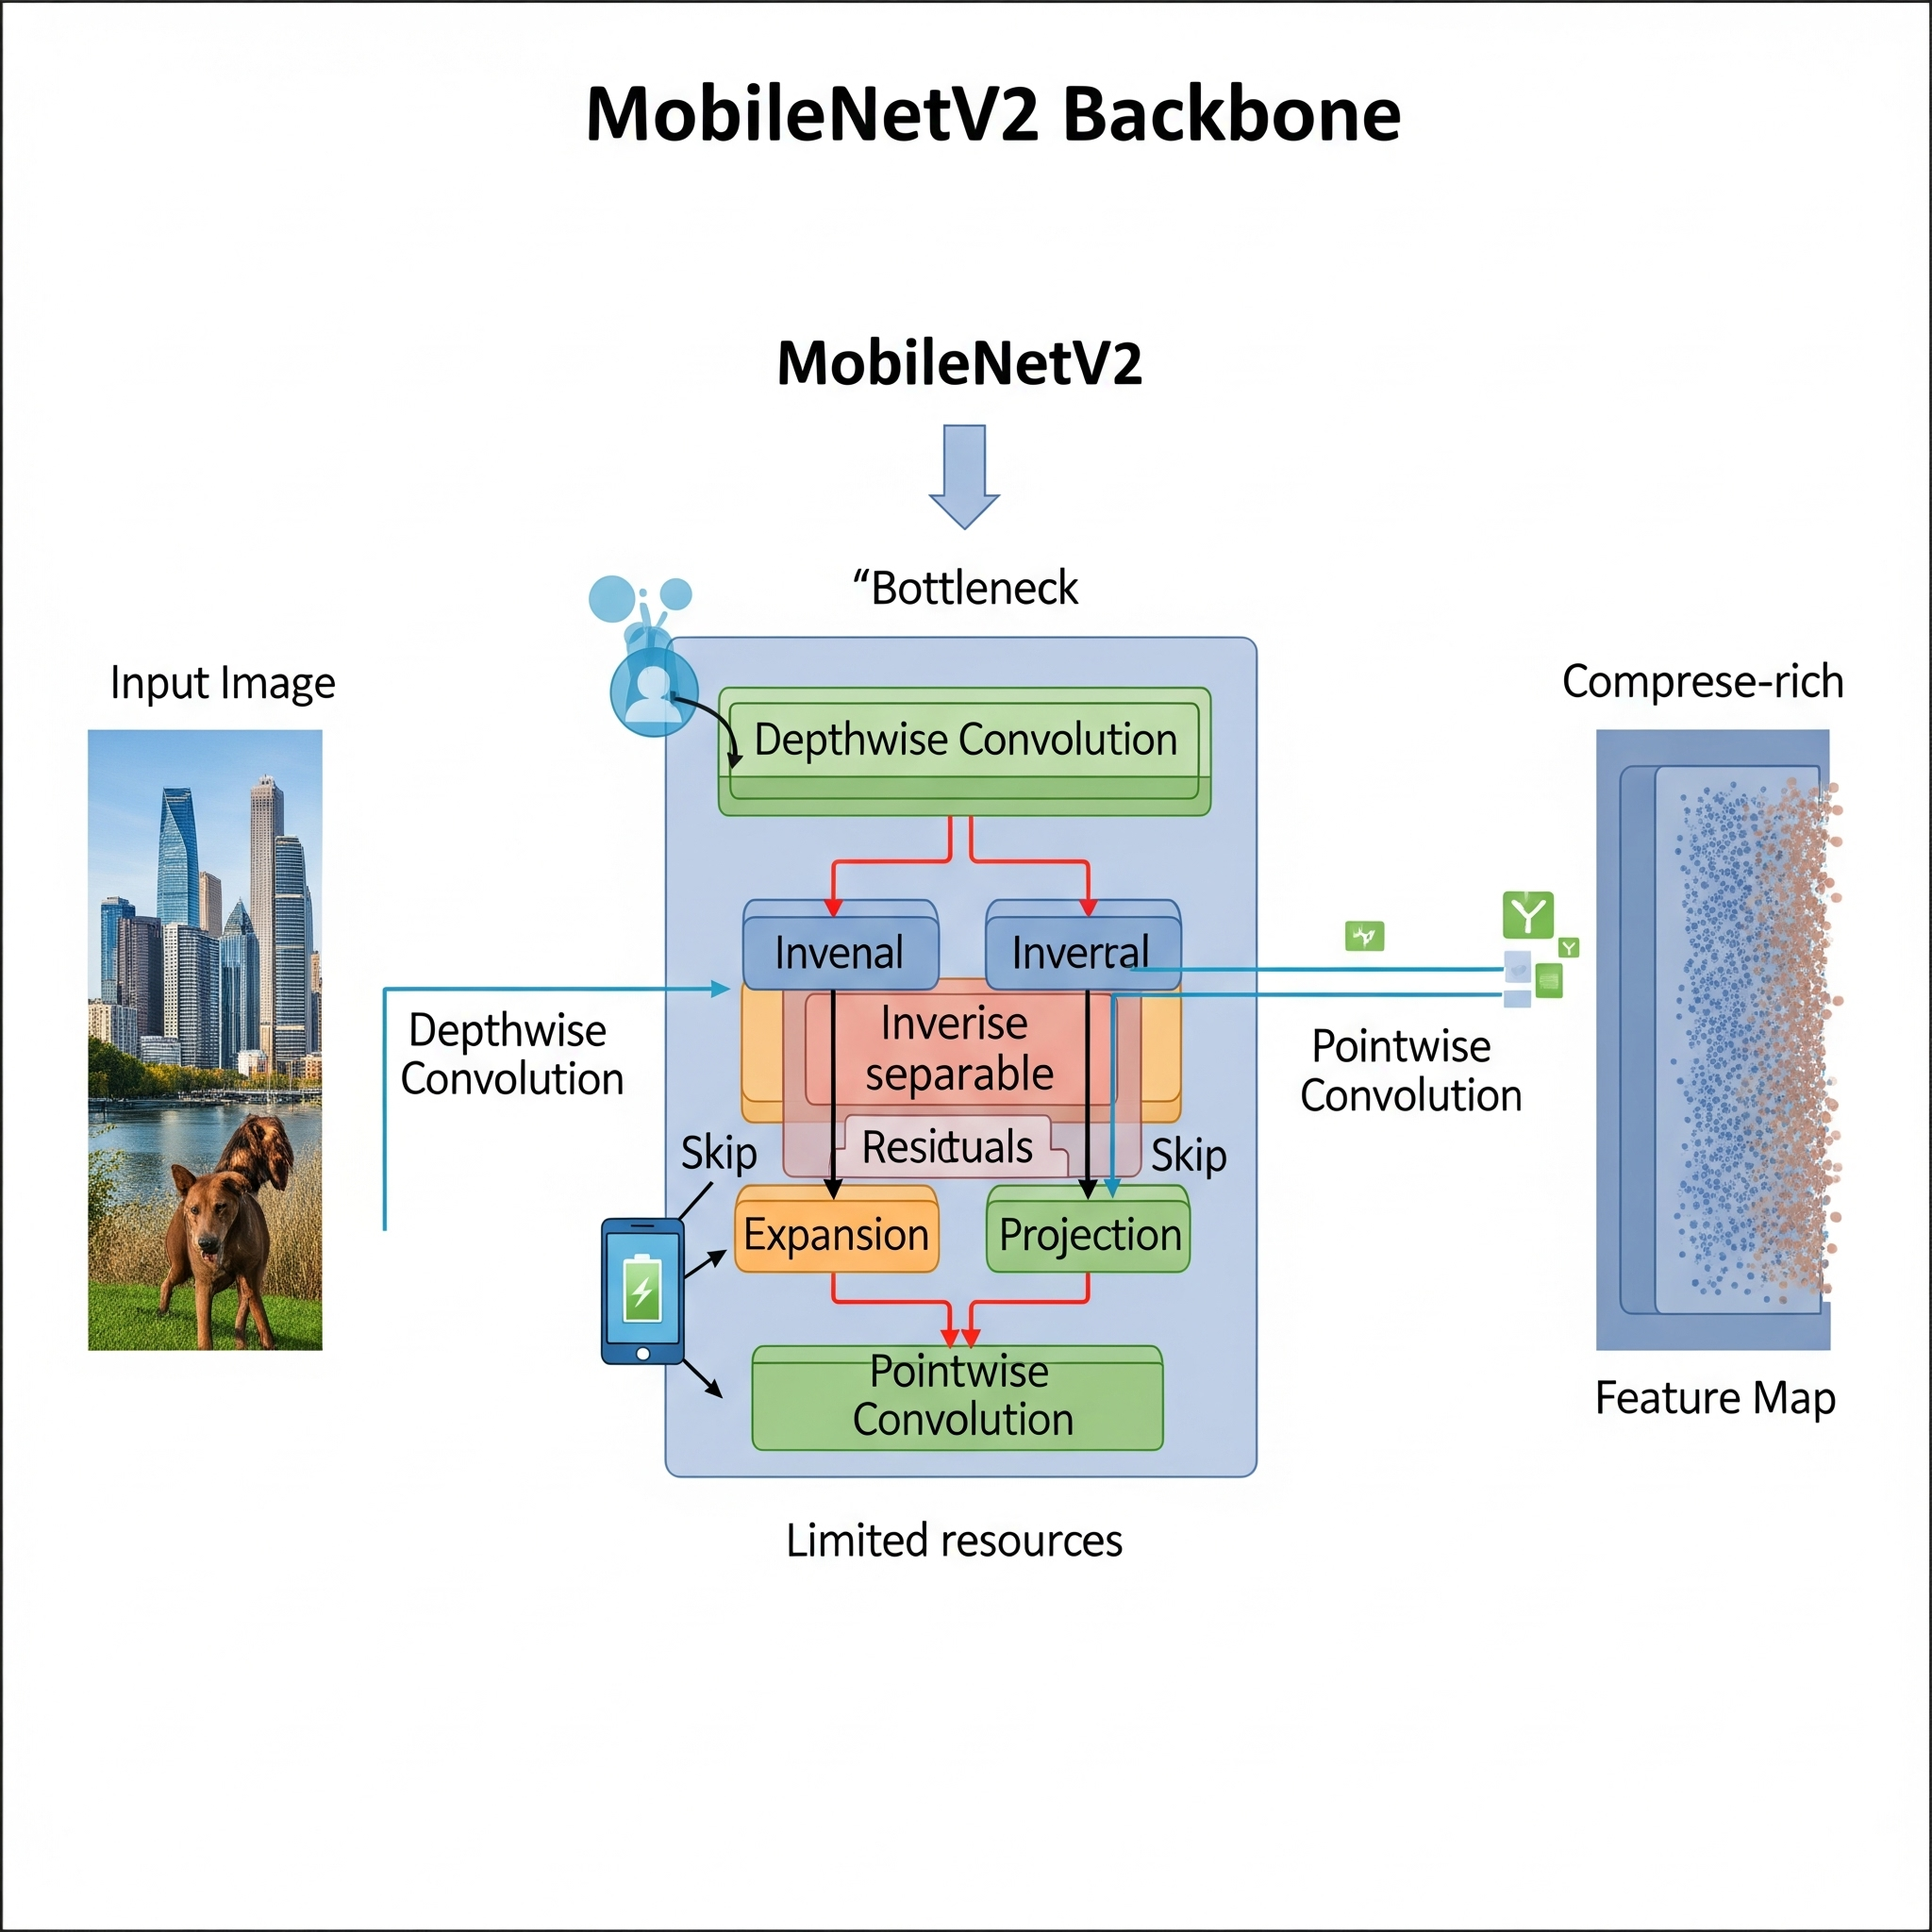
Model Architecture (1): The Backbone
Extract meaningful features from the image
Standard YOLOv3 uses Darknet-53 backbone
Proposed model utilizes MobileNetV2 backbone
Why MobileNetV2 ?
Designed for mobile and resource-constrained systems.
Provides high efficiency with fewer parameters and less computation (low FLOPS).
Goal: Maximum feature extraction with (Jetson Nano's) limited resources.

Slide 10
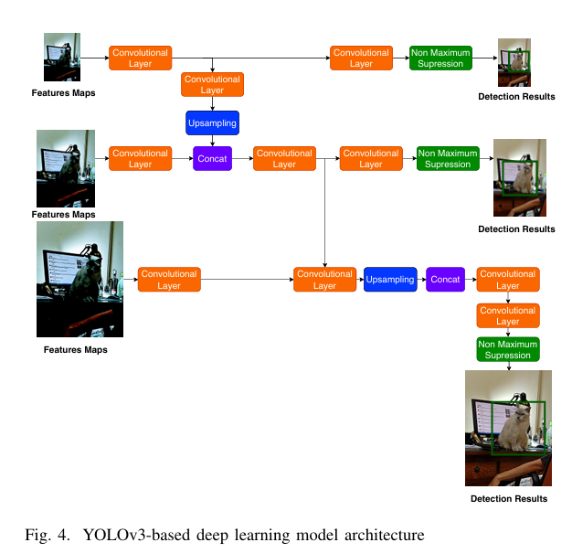
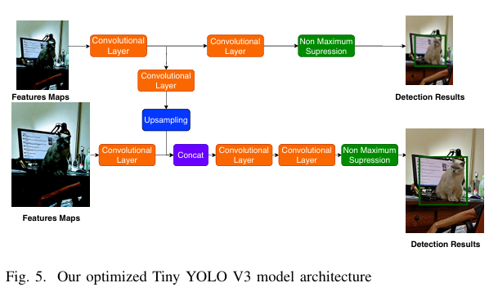
Model Architecture (2): Optimization (Novelty)
Standard YOLOv3 uses three detection scales. (Large, Medium, Small)
It has a more complex and heavier structure.
The optimized model uses two detection scales. (Novelty 1)
It has fewer convolutional layers for efficiency. (Novelty 2)
Result: A simpler, more compact, and faster architecture.

Slide 11
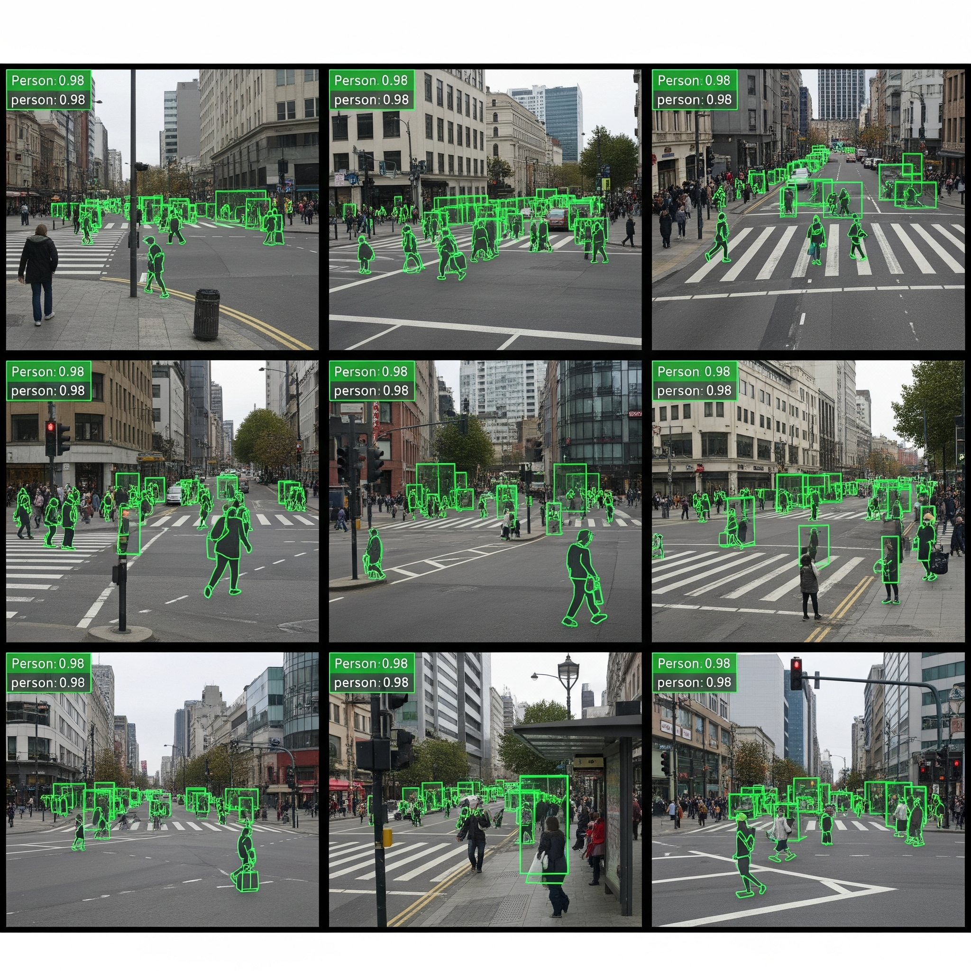
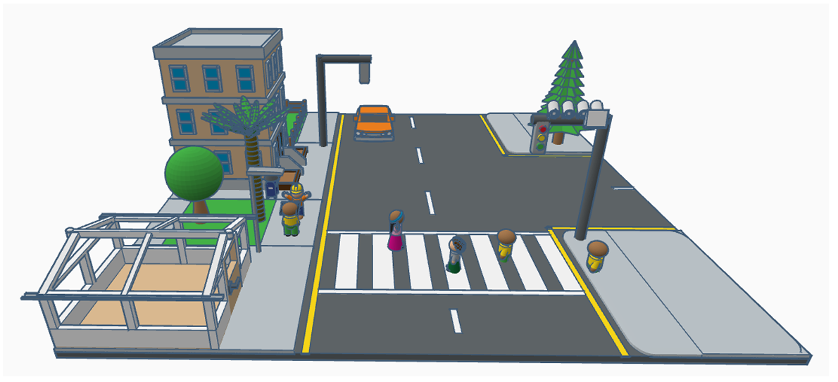
Training & Testing Environment
Training with the CrowdHuman dataset
Over 15,000 images and 470,000 annotations
Focus on crowded and occluded scenarios
Realistic 3D simulation for testing
Utilized Unity and Traffic3D Library

Slide 12
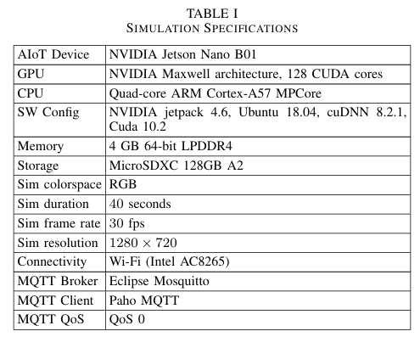
Test Hardware & Competitors
NVIDIA RTX 3090 provides performance baseline
NVIDIA Jetson Nano B01 is the target device
Compare with Faster R-CNN and RetinaNet
Evaluate against SSD, EfficientNet, and YOLOv3

Slide 13
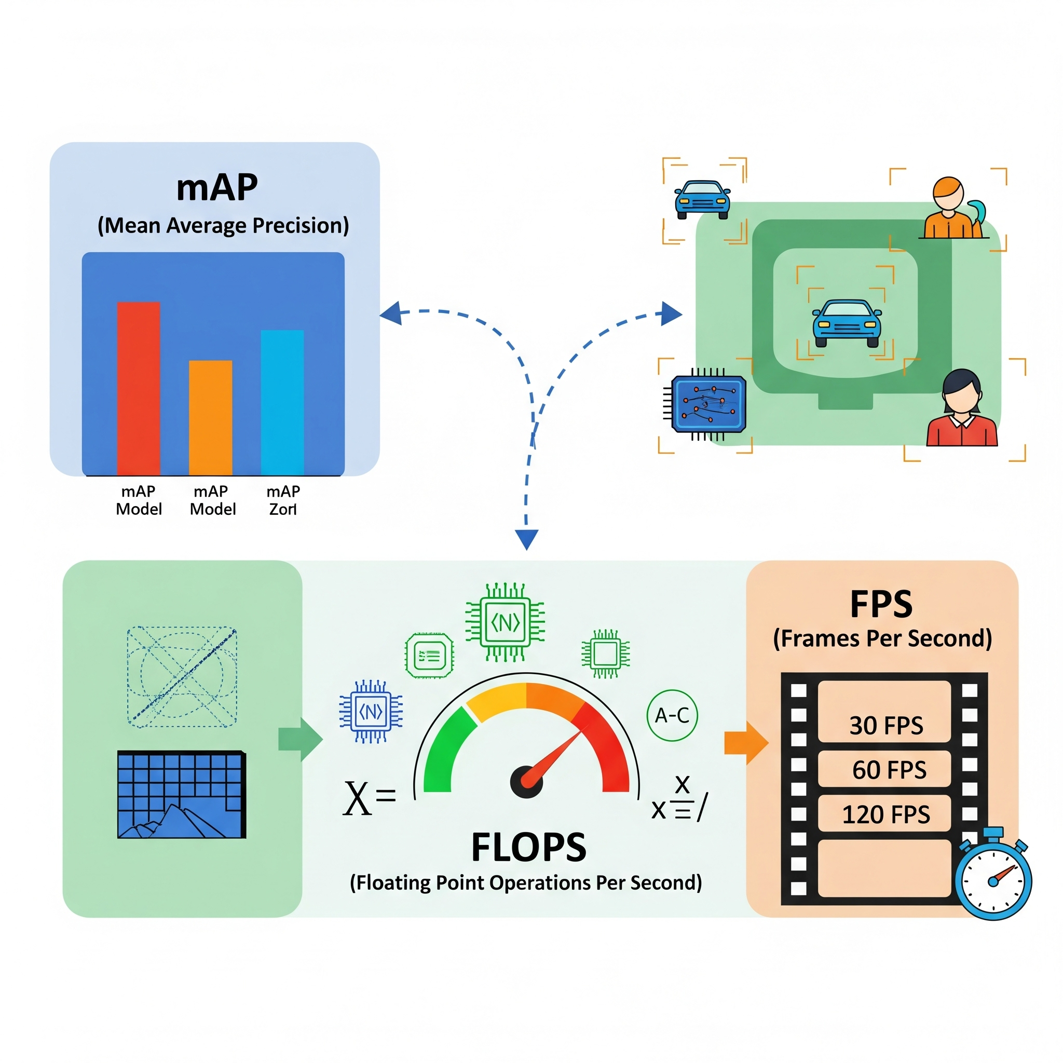
How Was Success Measured? (Metrics)
mAP(Mean Average Precision) measures accuracy: higher is better
FLOPS measures efficiency: lower is better
Model size is measured by parameters: lower is better
Inference time and latency: lower is better
FPS measures real-world speed: higher is better
Memory usage in MB: lower is better

Slide 14
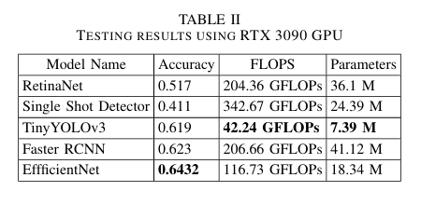
Results (1): Theoretical Test on RTX 3090
Proposed Tiny YOLO has high accuracy
It is very close to competitors like EfficientNet
Tiny YOLO model size is much smaller
It uses significantly fewer parameters
Accuracy (mAP):
EfficientNet: 0.643
Faster R-CNN: 0.623
Proposed (Tiny YOLO): 0.619 (Very close to the competitors!)
Parameters (Size):
Faster R-CNN: 41.12 M
Proposed (Tiny YOLO): 7.39 M (~6x smaller)
First Takeaway: In theory, the model achieves nearly the same accuracy with far fewer resources.

Slide 15
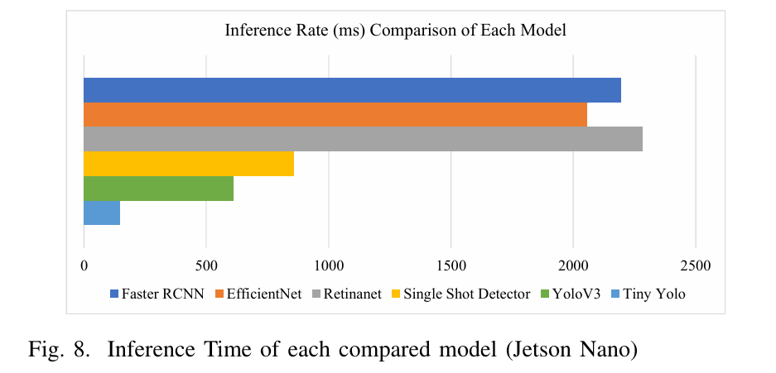
Results (2): The Speed Test on Jetson Nano B01
Proposed Tiny YOLO model is the fastest
Tiny YOLO achieves 423 ms inference time
Faster R-CNN and EfficientNet are too slow
Original YOLOv3 is slower than our model
Second Takeaway: The proposed model is the fastest on the Jetson Nano.
Faster R-CNN: ~2200 ms (2.2 seconds - Unusable!)
EfficientNet: ~2000 ms (2.0 seconds - Unusable!)
Original YOLOv3: 610 ms (0.6 seconds)
Proposed (Tiny YOLO): 423 ms (0.4 seconds)

Slide 16
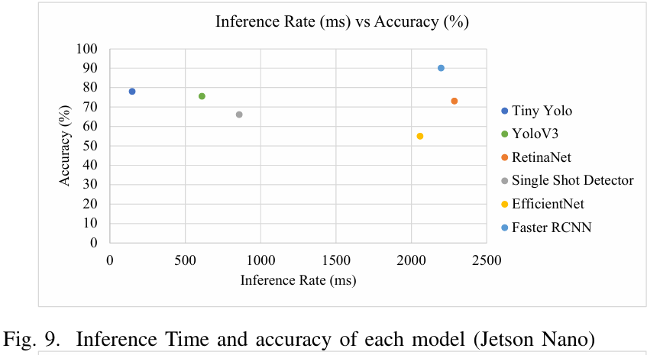
Results (3): The Engineering Trade-off
The proposed model balances speed and accuracy.
Faster R-CNN offers high accuracy but is slower.
Tiny YOLO is very fast with good accuracy.
Speed is crucial for real-time safety applications.
Third Takeaway: For safety, being 'fast enough' is more critical than being 'the most accurate'.
Y-Axis: Accuracy (Higher is better)
X-Axis: Speed (ms) (Left is better)
Faster R-CNN (Top Right): Highest Accuracy, Slowest Speed.
Proposed (Tiny YOLO) (Top Left): Very Fast (423ms), Very Good Accuracy (78%).

Slide 17
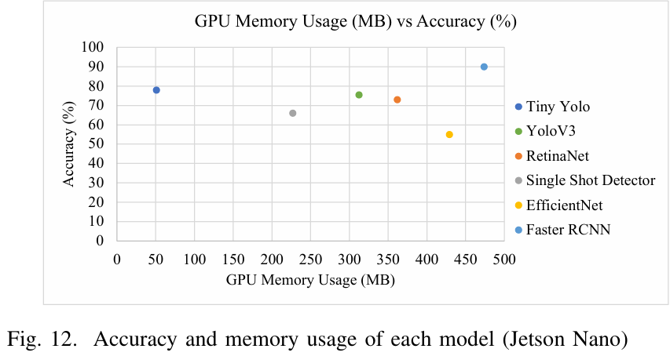
Results (4): Resource Usage (RAM)
Tiny YOLO uses significantly less RAM
Faster R-CNN and YOLOv3 use much more memory
Proposed model uses only 50.81 MB RAM
Our model is highly efficient in memory usage
Fourth Takeaway: The proposed model uses 6x less RAM than its closest competitor
GPU Memory Usage:
Faster R-CNN: ~480 MB
Original YOLOv3: ~312 MB
Proposed (Tiny YOLO): 50.81 MB

Slide 18
3 Key Takeaways
1. Edge Computing is Critical:
High-latency Cloud systems are not viable for real-time safety applications. The solution is local (edge) processing.
2. The 'Best' vs. The 'Fittest':
The "heaviest" models (like Faster R-CNN) become unusable on constrained IoT devices (like Jetson Nano) due to their slowness. The key is the balance of Speed/Accuracy/Resources.
3. Smart Optimization Works:
This study proved that (MobileNetV2 + 2-Scale YOLO) can create a model that is faster, lighter, and even more accurate than the standard model.

Slide 19
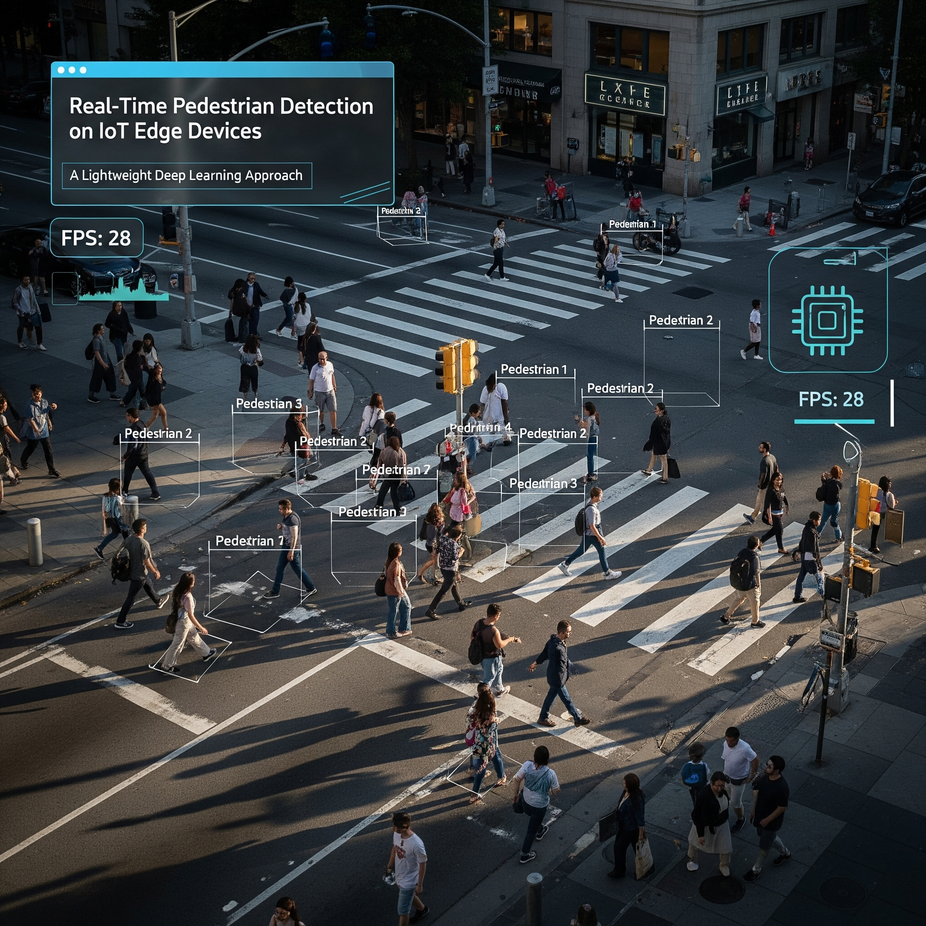
Future Work & Closing
System needs to move out of simulation
Integrate with real-world LTE or 5G networks
Test end-to-end latency in real conditions
Paper Info:
'Real-Time Pedestrian Detection on IoT Edge Devices: A Lightweight Deep Learning Approach'
M. D. Alfikri, R. Kaliski
arXiv:2409.15740v1

Slide 20
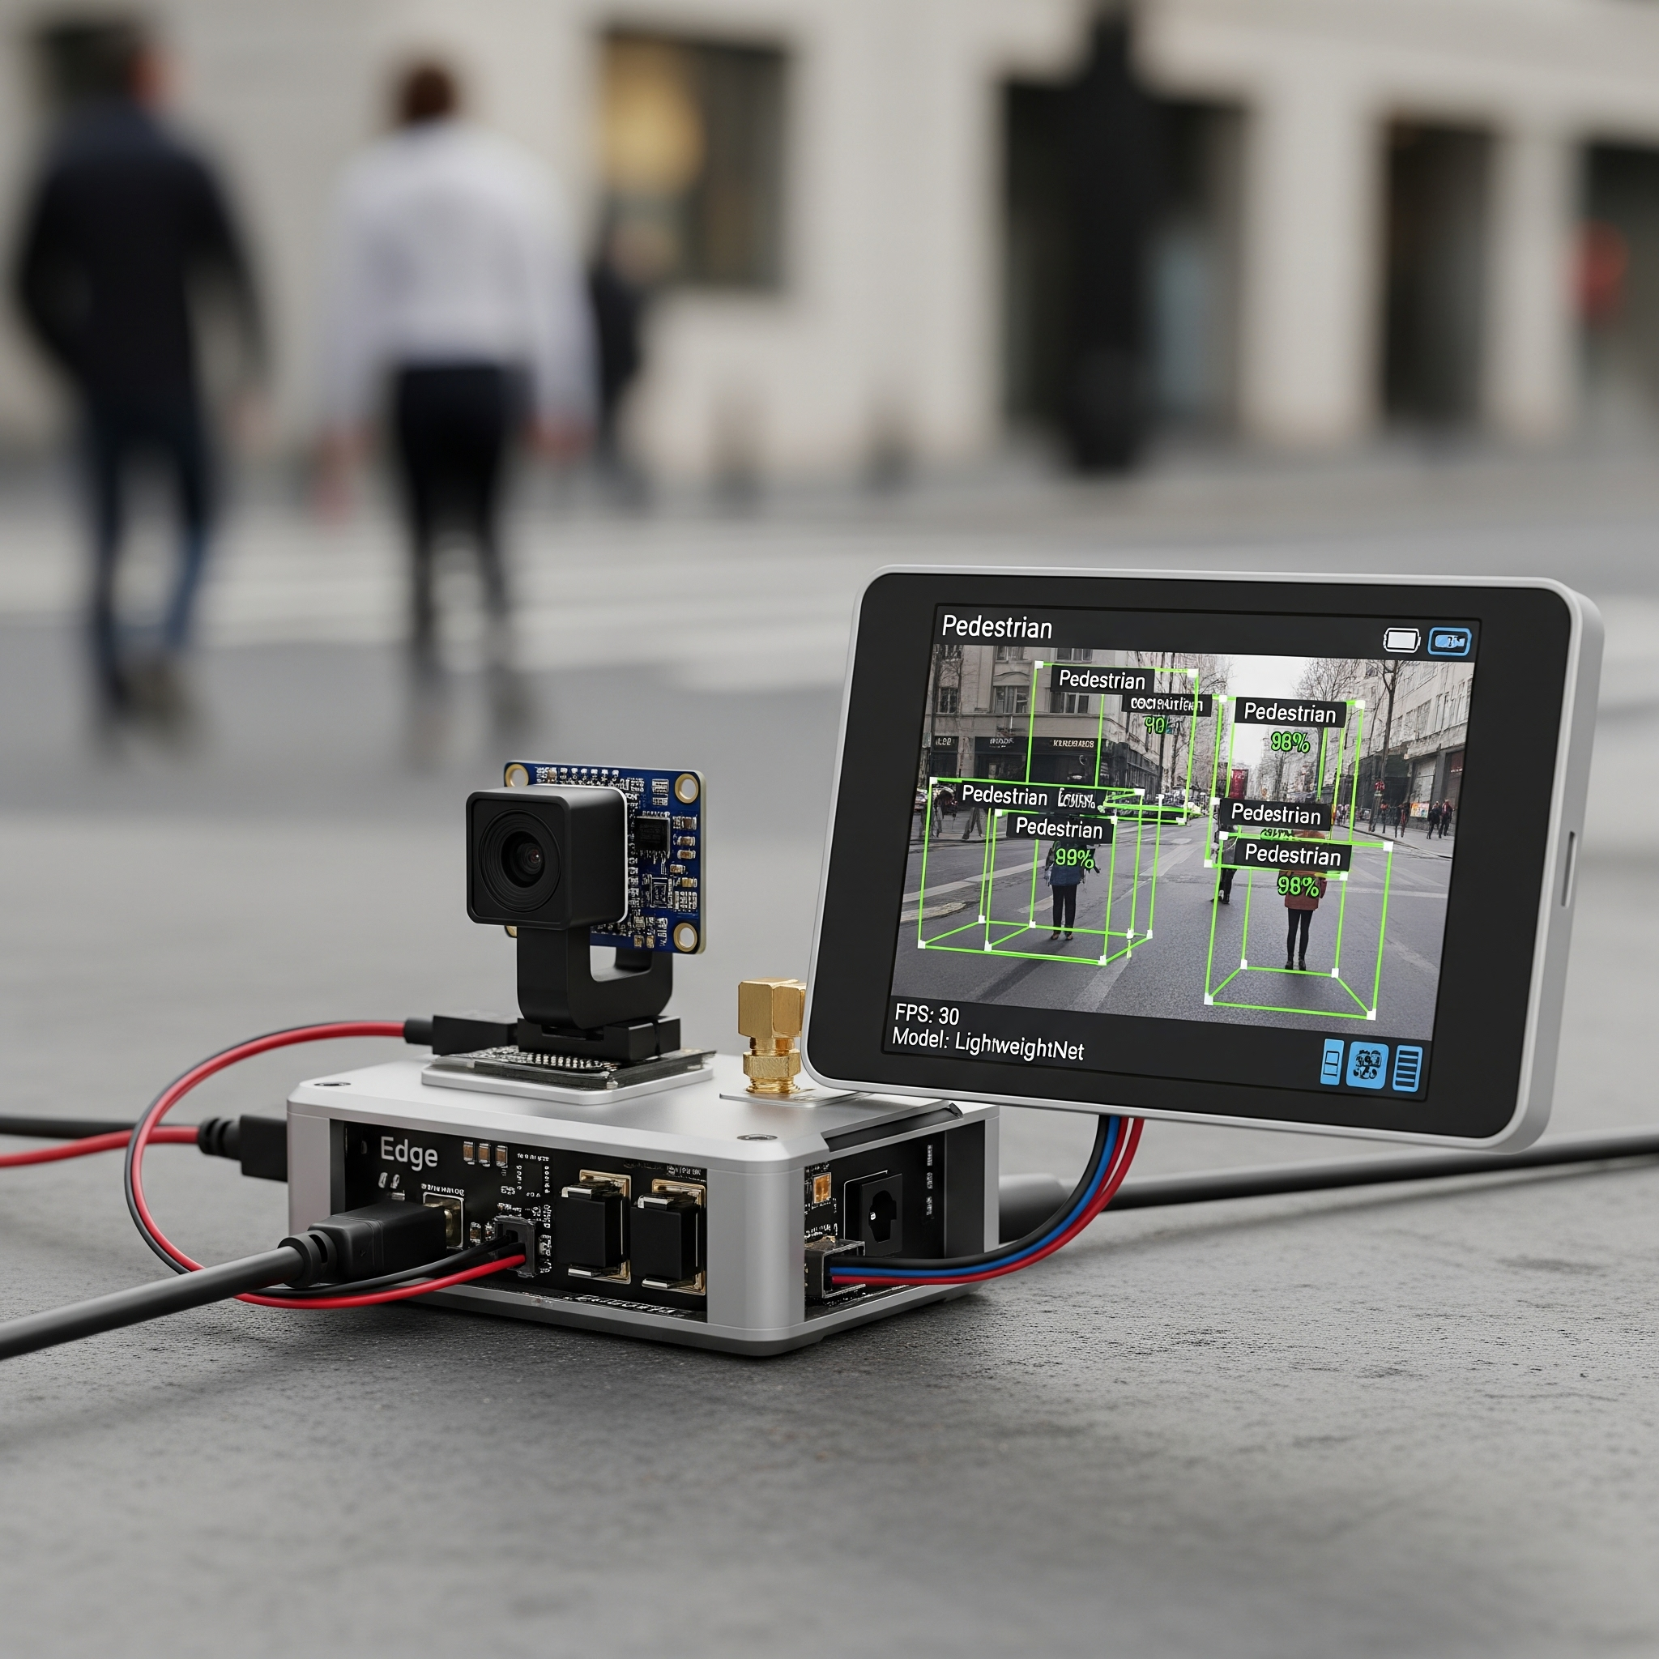
Thank You & Questions
Thank you for your attention.
I welcome any questions you may have.

